Slide 1
Ecosystems Unit Activity 3.5 Tracing Energy Through an Ecosystem
Carbon: Transformations in Matter and Energy
Environmental Literacy Project Michigan State University

Slide 2
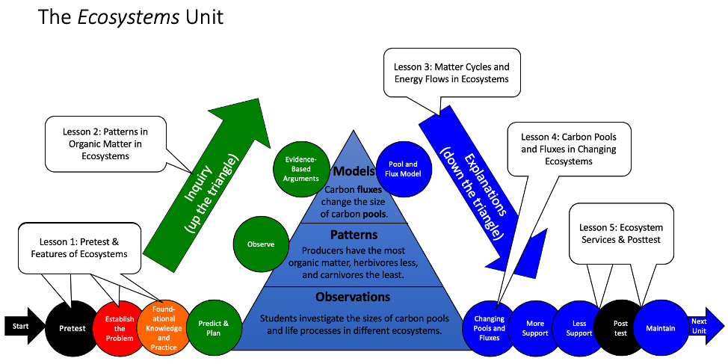
Unit map
You are here
Notes:
Use the instructional model to show students where they are in the course of the unit.
Show Slide 2 of the 3.5 Tracing Energy PPT.

Slide 3
Tracing Energy Through an Ecosystem
Remember the yellow twist ties in the Carbon Dice Game? These represented energy as it moved through different carbon pools.
Where did most of the twist ties end up in the game?
Let’s explore why this pattern emerged, starting with the Energy Question.
Notes:
Revisit the energy patterns from the Carbon Dice Game.
Using Slide 3, remind students of how they traced energy movement with yellow twist ties in Activity 3.2 Carbon Dice Game. Ask: Where did most of the twist ties end up in the game? Solicit student ideas about energy flow through carbon pools from the Game.
Accommodation: Before beginning this Activity, review the results of 3.2 The Carbon Dice Game.

Slide 4
Tracing Energy Through an Ecosystem
How does energy flow through environmental systems?
To answer this, let’s break it down:
Where does the energy come from?
How is energy transformed in an ecosystem?
How does energy move through ecosystem pools?
Let’s start with question 1…
Notes:
Practice tracing energy.
Use Slides 4-13 to help students think about the Energy Flow Question and the process of tracing energy. These slides are animated, so view them in presentation mode for the best effect. Be sure to explain that all energy in the ecosystem is eventually converted into heat energy, which is released to the atmosphere. Heat energy dissipates, moves through the atmosphere and ultimately is radiated into space.
Accommodation: As you go through Slides 4-13, provide students with guided notes that include the information from the slides with a few words taken out so students can fill in the information during the lecture. Encourage students to use different colors to depict different forms of energy (i.e. yellow for sunlight energy, green for chemical energy, and red for heat and motion energy) while taking notes.

Slide 5
1. Where does the energy come from?
The energy comes from the sun.
Through the process of photosynthesis, plants absorb sunlight energy and convert it into chemical energy sequestered the in C-C and C-H bonds of sugar molecules.
Notes:
Practice tracing energy.
Use Slides 4-13 to help students think about the Energy Flow Question and the process of tracing energy. These slides are animated, so view them in presentation mode for the best effect. Be sure to explain that all energy in the ecosystem is eventually converted into heat energy, which is released to the atmosphere. Heat energy dissipates, moves through the atmosphere and ultimately is radiated into space.
Accommodation: As you go through Slides 4-13, provide students with guided notes that include the information from the slides with a few words taken out so students can fill in the information during the lecture. Encourage students to use different colors to depict different forms of energy (i.e. yellow for sunlight energy, green for chemical energy, and red for heat and motion energy) while taking notes.
Image Credit: Craig Douglas, Michigan State University

Slide 6
2. How is energy transformed in an ecosystem?
The 1st transition was from sunlight energy to chemical energy in plants through photosynthesis.
The 2nd transition is when plants, animals, and decomposers do cellular respiration and convert chemical energy to heat or motion energy.
Notes:
Practice tracing energy.
Use Slides 4-13 to help students think about the Energy Flow Question and the process of tracing energy. These slides are animated, so view them in presentation mode for the best effect. Be sure to explain that all energy in the ecosystem is eventually converted into heat energy, which is released to the atmosphere. Heat energy dissipates, moves through the atmosphere and ultimately is radiated into space.
Accommodation: As you go through Slides 4-13, provide students with guided notes that include the information from the slides with a few words taken out so students can fill in the information during the lecture. Encourage students to use different colors to depict different forms of energy (i.e. yellow for sunlight energy, green for chemical energy, and red for heat and motion energy) while taking notes.
Image Credit: Craig Douglas, Michigan State University

Slide 7
2. How is energy transformed in an ecosystem?
Chemical energy is transformed into motion energy when:
molecules move in and out of cells to do biosynthesis
organs and body parts move
Chemical energy is transformed into heat energy when:
motion energy occurs
cellular respiration happens
Notes:
Practice tracing energy.
Use Slides 4-13 to help students think about the Energy Flow Question and the process of tracing energy. These slides are animated, so view them in presentation mode for the best effect. Be sure to explain that all energy in the ecosystem is eventually converted into heat energy, which is released to the atmosphere. Heat energy dissipates, moves through the atmosphere and ultimately is radiated into space.
Accommodation: As you go through Slides 4-13, provide students with guided notes that include the information from the slides with a few words taken out so students can fill in the information during the lecture. Encourage students to use different colors to depict different forms of energy (i.e. yellow for sunlight energy, green for chemical energy, and red for heat and motion energy) while taking notes.
Image Credit: Craig Douglas, Michigan State University

Slide 8
3. How does energy move through ecosystem pools?
Plants convert sunlight energy to chemical energy and store it in the C-C and C-H bonds of organic molecules.
These high-energy, organic molecules become part of the plant’s body (leaves, stems, and fruit) through biosynthesis.
Notes:
Practice tracing energy.
Use Slides 4-13 to help students think about the Energy Flow Question and the process of tracing energy. These slides are animated, so view them in presentation mode for the best effect. Be sure to explain that all energy in the ecosystem is eventually converted into heat energy, which is released to the atmosphere. Heat energy dissipates, moves through the atmosphere and ultimately is radiated into space.
Accommodation: As you go through Slides 4-13, provide students with guided notes that include the information from the slides with a few words taken out so students can fill in the information during the lecture. Encourage students to use different colors to depict different forms of energy (i.e. yellow for sunlight energy, green for chemical energy, and red for heat and motion energy) while taking notes.
Image Credit: Craig Douglas, Michigan State University

Slide 9
3. How does energy move through ecosystem pools?
When plants are eaten by herbivores, those same high-energy, organic molecules move into the herbivores and become part of their bodies through biosynthesis.
When herbivores are eaten by carnivores, the high-energy, organic molecules move into the carnivores and become part of their bodies through biosynthesis.
Finally, when plants, herbivores, or carnivores die, the high-energy, organic molecules move into decomposers and become part of their bodies through biosynthesis.
Notes:
Practice tracing energy.
Use Slides 4-13 to help students think about the Energy Flow Question and the process of tracing energy. These slides are animated, so view them in presentation mode for the best effect. Be sure to explain that all energy in the ecosystem is eventually converted into heat energy, which is released to the atmosphere. Heat energy dissipates, moves through the atmosphere and ultimately is radiated into space.
Accommodation: As you go through Slides 4-13, provide students with guided notes that include the information from the slides with a few words taken out so students can fill in the information during the lecture. Encourage students to use different colors to depict different forms of energy (i.e. yellow for sunlight energy, green for chemical energy, and red for heat and motion energy) while taking notes.
Image Credit: Craig Douglas, Michigan State University

Slide 10
3. How does energy move through ecosystem pools?
Therefore, a good rule to remember is:
When organic molecules move through an ecosystem, so does the chemical energy contained in the C-C and C-H bonds of those organic molecules.
Organic matter and chemical energy follow the same path!
Notes:
Practice tracing energy.
Use Slides 4-13 to help students think about the Energy Flow Question and the process of tracing energy. These slides are animated, so view them in presentation mode for the best effect. Be sure to explain that all energy in the ecosystem is eventually converted into heat energy, which is released to the atmosphere. Heat energy dissipates, moves through the atmosphere and ultimately is radiated into space.
Accommodation: As you go through Slides 4-13, provide students with guided notes that include the information from the slides with a few words taken out so students can fill in the information during the lecture. Encourage students to use different colors to depict different forms of energy (i.e. yellow for sunlight energy, green for chemical energy, and red for heat and motion energy) while taking notes.
Image Credit: Craig Douglas, Michigan State University

Slide 11
When do matter and energy NOT follow the same path?
This happens when chemical energy is converted to heat energy as plants, animals, and decomposers do cellular respiration.
During this process, the high-energy, C-C and C-H bonds in organic molecules are broken and low-energy, C-O and H-O bonds in inorganic molecules are formed, thereby releasing some of the chemical energy as heat energy.
This heat energy is LOST from the ecosystem (and eventually radiates into outer space).
Notes:
Practice tracing energy.
Use Slides 4-13 to help students think about the Energy Flow Question and the process of tracing energy. These slides are animated, so view them in presentation mode for the best effect. Be sure to explain that all energy in the ecosystem is eventually converted into heat energy, which is released to the atmosphere. Heat energy dissipates, moves through the atmosphere and ultimately is radiated into space.
Accommodation: As you go through Slides 4-13, provide students with guided notes that include the information from the slides with a few words taken out so students can fill in the information during the lecture. Encourage students to use different colors to depict different forms of energy (i.e. yellow for sunlight energy, green for chemical energy, and red for heat and motion energy) while taking notes.
Image Credit: Craig Douglas, Michigan State University

Slide 12
When do matter and energy NOT follow the same path?
So…
Chemical energy follows organic molecules through an ecosystem.
When organic molecules are converted into inorganic molecules, heat energy leaves the ecosystem while the inorganic molecules get recycled.
Notes:
Practice tracing energy.
Use Slides 4-13 to help students think about the Energy Flow Question and the process of tracing energy. These slides are animated, so view them in presentation mode for the best effect. Be sure to explain that all energy in the ecosystem is eventually converted into heat energy, which is released to the atmosphere. Heat energy dissipates, moves through the atmosphere and ultimately is radiated into space.
Accommodation: As you go through Slides 4-13, provide students with guided notes that include the information from the slides with a few words taken out so students can fill in the information during the lecture. Encourage students to use different colors to depict different forms of energy (i.e. yellow for sunlight energy, green for chemical energy, and red for heat and motion energy) while taking notes.
Image Credit: Craig Douglas, Michigan State University

Slide 13
Energy Flow in an Ecosystem
If chemical energy follows organic molecules, then let’s review how organic molecules are formed, transported, and removed in an ecosystem to see how energy flows, too.
Get out your Tracing Energy Worksheet…
Notes:
Practice tracing energy.
Use Slides 4-13 to help students think about the Energy Flow Question and the process of tracing energy. These slides are animated, so view them in presentation mode for the best effect. Be sure to explain that all energy in the ecosystem is eventually converted into heat energy, which is released to the atmosphere. Heat energy dissipates, moves through the atmosphere and ultimately is radiated into space.
Accommodation: As you go through Slides 4-13, provide students with guided notes that include the information from the slides with a few words taken out so students can fill in the information during the lecture. Encourage students to use different colors to depict different forms of energy (i.e. yellow for sunlight energy, green for chemical energy, and red for heat and motion energy) while taking notes.
Image Credit: Craig Douglas, Michigan State University

Slide 14
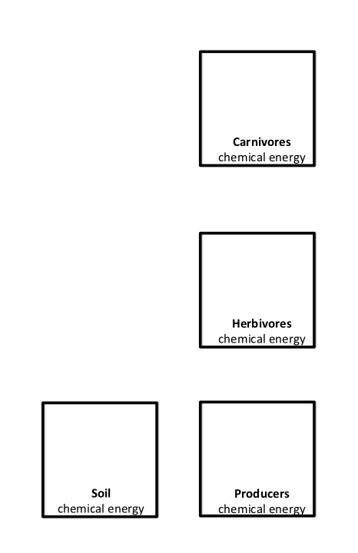
Energy Flow in an Ecosystem
Follow the instructions on the worksheet to trace matter and energy through an ecosystem.
Notes:
Students complete Part A of worksheets and compare responses.
Give each student a copy of 3.5 Tracing Energy Worksheet. Have students try to complete the first page on their own, and then have them compare with a neighbor to see if they both agree on all of the processes.
Show Slide 14 of 3.5 Tracing Energy PPT while they work.
You may want to tell students to draw a sun on the worksheet to indicate the initial source of energy for ecosystems.

Slide 15
Carnivores
chemical energy
heat energy
cellular respiration
eating
death and defecation
heat energy
Herbivores
chemical energy
cellular respiration
sunlight energy
death and defecation
photosynthesis
cellular respiration
heat energy
eating
Soil
chemical energy
Producers
chemical energy
heat energy
death
cellular respiration
Notes:
Students complete Part B and discuss the movement and transformation of energy between carbon pools.
Have students answer questions 4-7 on the second page of the 3.5 Tracing Energy Worksheet based on what they just learned.
Use Slide 15 to discuss the answer to the Energy Flow Question. Have students compare this to the answers that they wrote on their worksheet.

Slide 16
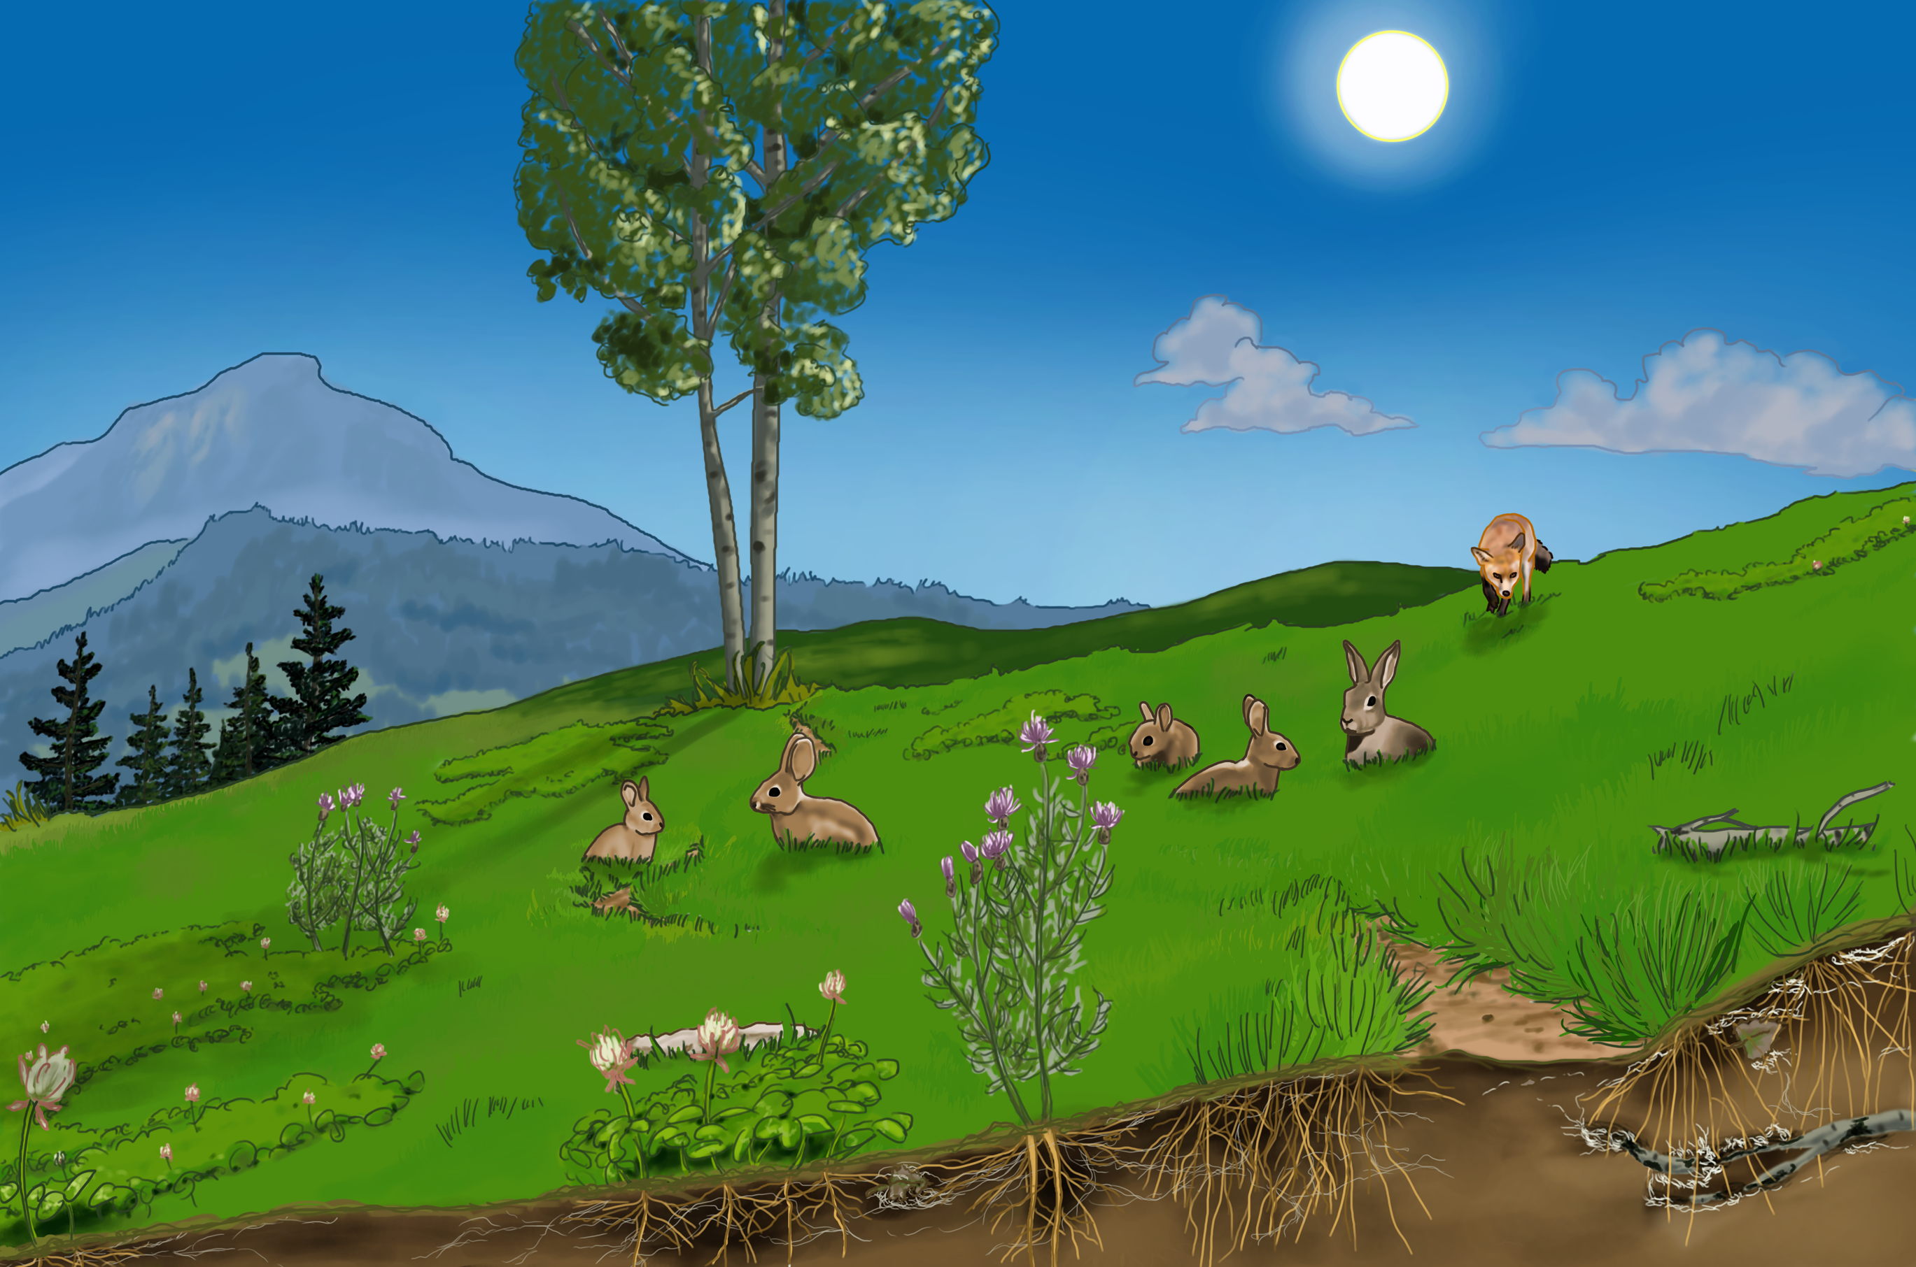
Energy Flows
Notes:
Answer the Energy Flow Question
Review energy flows in an ecosystem with the animations on Slide 16. Be sure to view it in presentation mode to see the animations.
Image Credit: Craig Douglas, Michigan State University

Slide 17
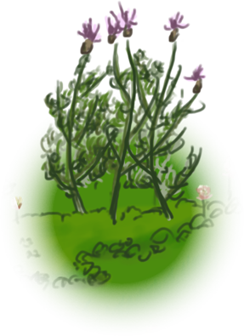
Energy and the Organic Matter Pyramid
When we traced carbon through organic matter pools, we saw that there were fewer carbon atoms at each trophic level due to cellular respiration. Fewer carbon atoms means fewer animals at each level. This resulted in the organic matter pyramid.
Since we know chemical energy follows organic molecules, what would the distribution of energy in an ecosystem look like?
Carnivores
Herbivores
Producers
Notes:
Answer the Energy Flow Question
Use Slides 17-18 to link energy flows with the organic matter pyramid.
On Slide 17, ask students what they think the distribution of energy looks like in an ecosystem. Have them explain their reasoning to the class.
Image Credit: Craig Douglas, Michigan State University

Slide 18
Energy and the Organic Matter Pyramid
It looks the same as the organic matter pyramid! Cellular respiration results in the loss of BOTH matter (i.e., carbon) and energy from organisms to form the energy and organic matter pyramids.
Carnivores
Herbivores
Producers
Notes:
Answer the Energy Flow Question
Review energy flows in an ecosystem with the animations on Slide 16. Be sure to view it in presentation mode to see the animations.
Use Slides 17-18 to link energy flows with the organic matter pyramid.
Slide 18 explains it would look the same as the organic matter pyramid.
Image Credit: Craig Douglas, Michigan State University

Slide 19
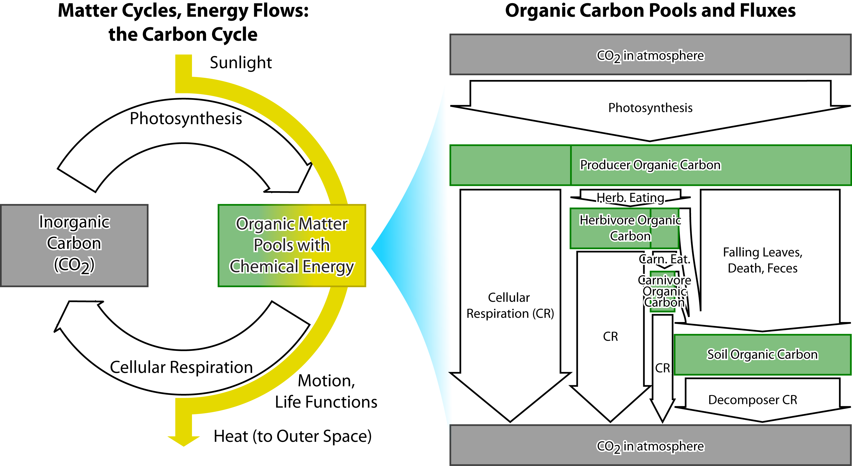
Matter and Energy in Ecosystems
Notes:
Reviewing Matter Cycles and Energy Flow
Use Slides 19-22 to review with students how matter and energy move through an ecosystem.
Slide 19 show the summative figure depicting how matter and energy move through an ecosystem.
Image Credit: Craig Douglas, Michigan State University

Slide 20
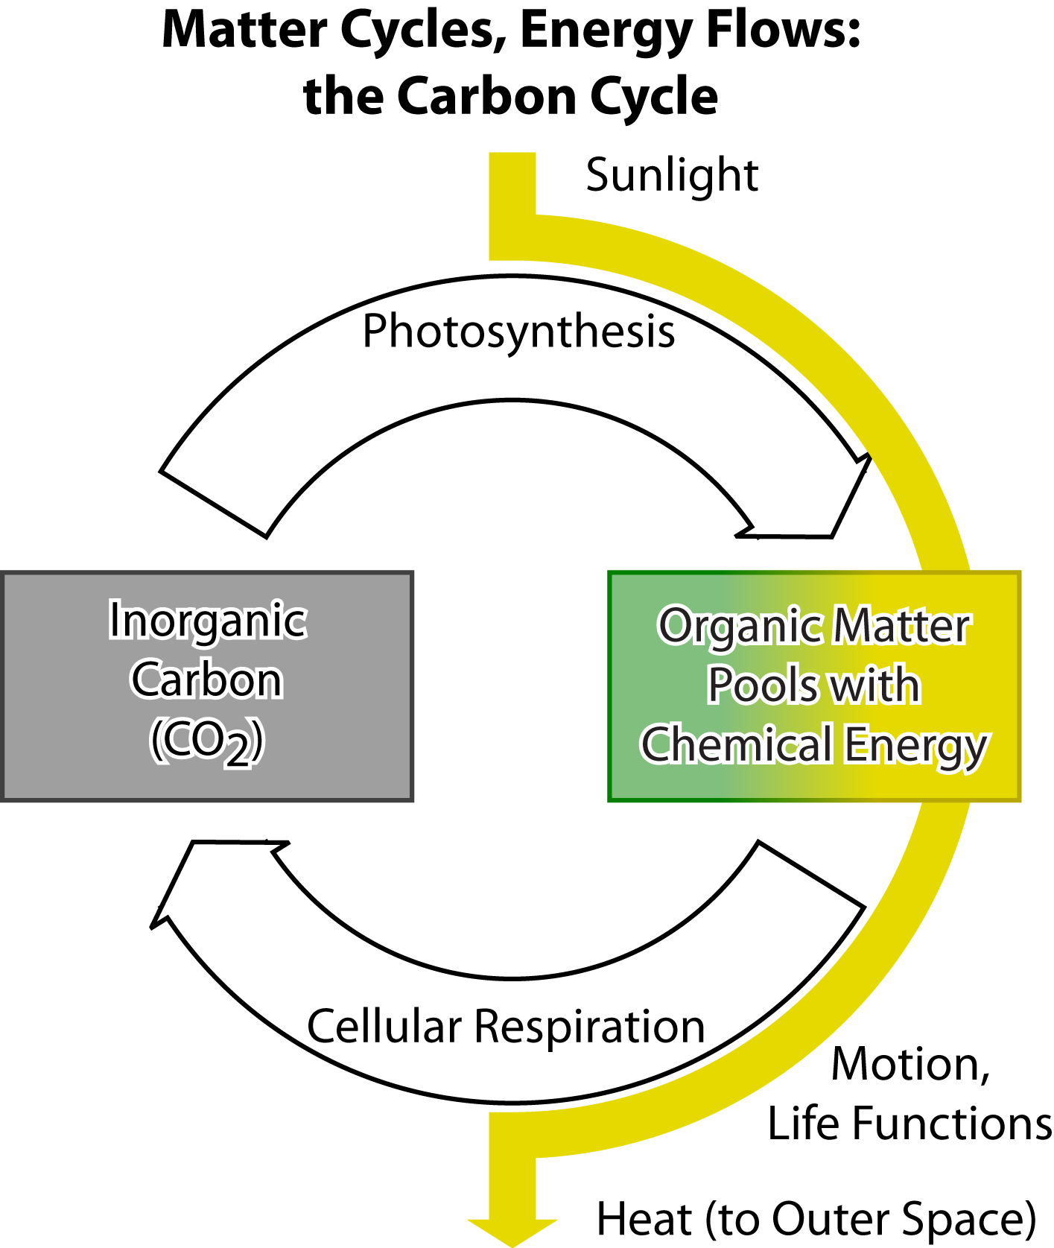
Matter and Energy in Ecosystems
Throughout Lesson 3, you’ve traced carbon and energy through an ecosystem, discovering these important points:
Matter cycles through an ecosystem from the atmosphere -> organic molecules (photosynthesis) -> atmosphere (cellular respiration).
Energy flows through an ecosystem from the sun-> chemical energy (via photosynthesis) -> heat energy radiated out to space (via cellular respiration)
Notes:
Reviewing Matter Cycles and Energy Flow
Use Slides 19-22 to review with students how matter and energy move through an ecosystem.
Slides 20-21 provide four key concepts from this Lesson about matter and energy in an ecosystem. Discuss with students how each of the concepts is portrayed in the figures.
Image Credit: Craig Douglas, Michigan State University

Slide 21
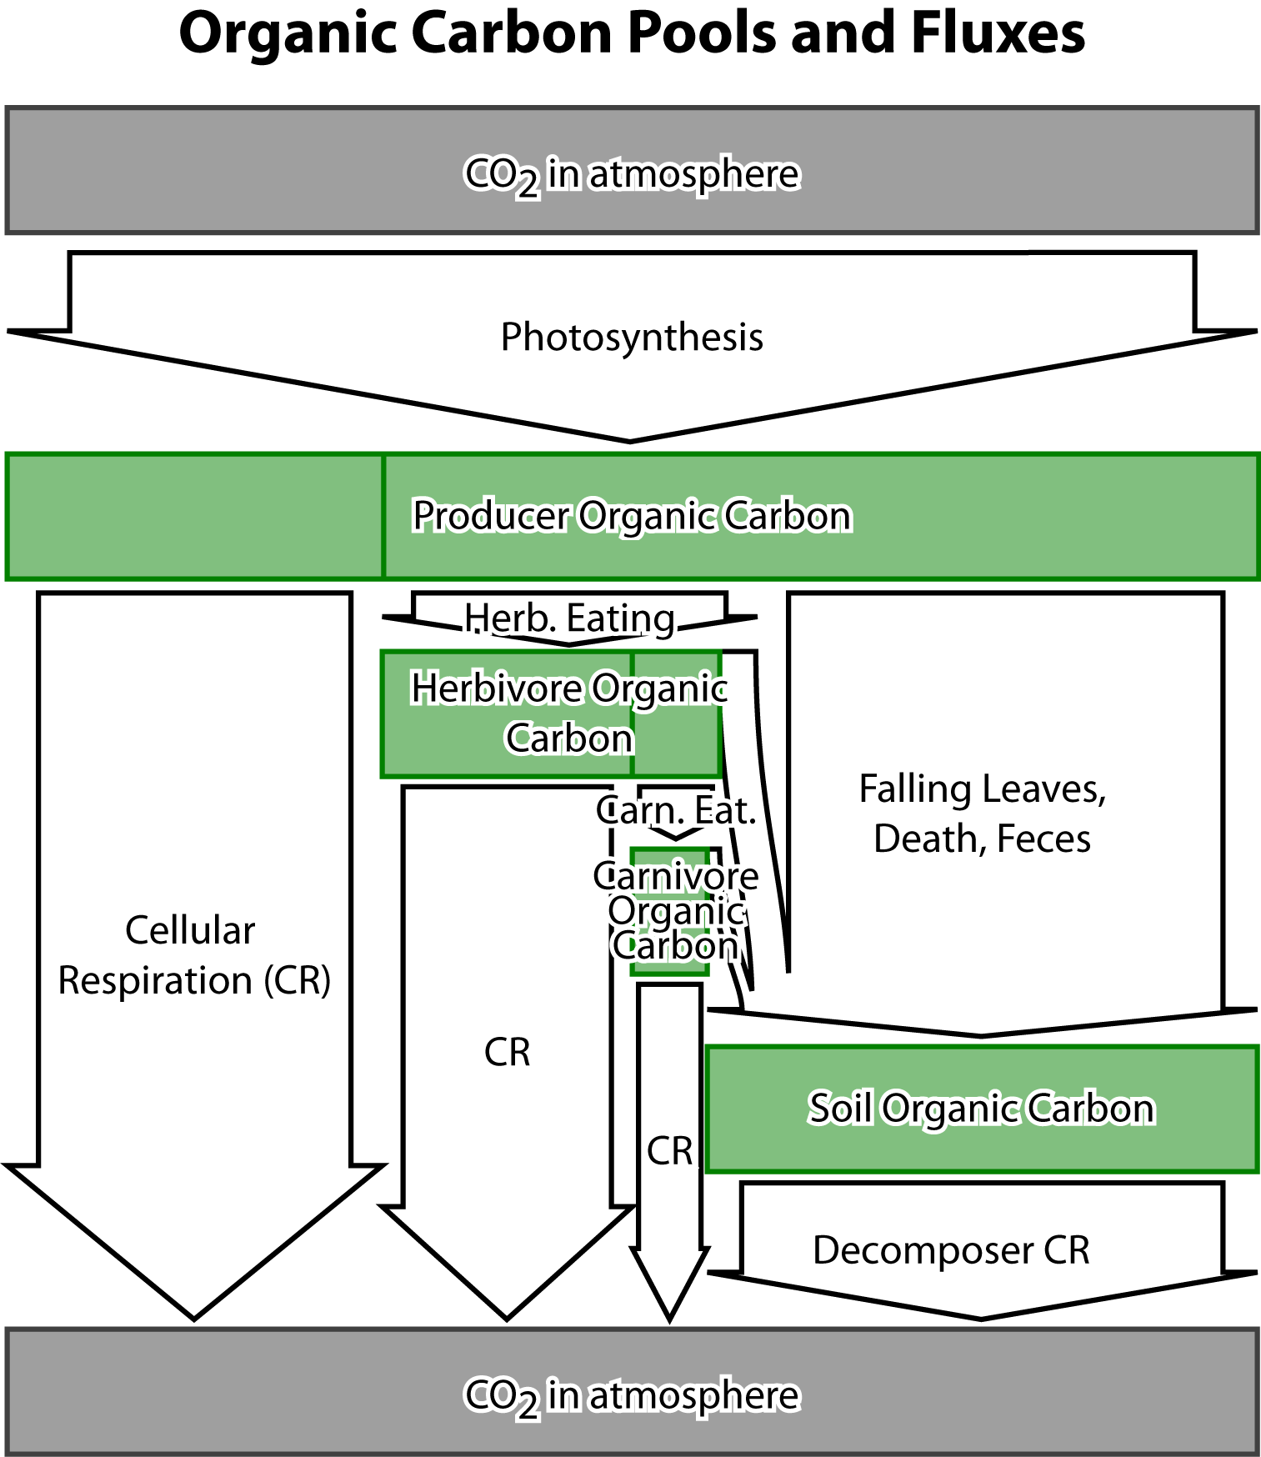
Matter and Energy in Ecosystems
Photosynthesis brings matter AND energy into an ecosystem, converting inorganic carbon to organic carbon, and sunlight energy to chemical energy.
Herbivores, carnivores, and decomposers ALL depend on producers to satisfy their matter (for biosynthesis) and energy (for movement and cellular processes) needs.
Notes:
Reviewing Matter Cycles and Energy Flow
Use Slides 19-22 to review with students how matter and energy move through an ecosystem.
Slides 20-21 provide four key concepts from this Lesson about matter and energy in an ecosystem. Discuss with students how each of the concepts is portrayed in the figures.
Image Credit: Craig Douglas, Michigan State University

Slide 22
Matter and Energy in Ecosystems
Notes:
Reviewing Matter Cycles and Energy Flow
Use Slides 19-22 to review with students how matter and energy move through an ecosystem.
Return to the figure on Slide 22 to ask some more in-depth questions about its content, such as: Where is the organic matter pyramid on the figure? Why doesn’t energy cycle like matter? What ultimately happens to most of the carbon that enters the ecosystem through photosynthesis? (answer: it is returned to the atmosphere through cellular respiration carried out by producers, herbivore, carnivores, and decomposers)
Image Credit: Craig Douglas, Michigan State University

Slide 23
Exit Ticket
Conclusions
What is the only way that energy gets into living plants, animals and decomposers?
Predictions
How are matter cycling and energy flow alike and different?
Notes:
Have students complete an exit ticket.
Show Slide 23 of the 3.5 Tracing Energy PPT.
Conclusions: What is the only way that energy gets into living plants, animals, and decomposers?
Predictions: How are matter cycling and energy flow alike and different?
On a sheet of paper or a sticky note, have students individually answer the exit ticket questions. Depending on time, you may have students answer both questions, assign students to answer a particular question, or let students choose one question to answer. Collect and review the answers.
The conclusions question will provide you with information about what your students are taking away from the activity. Student answers to the conclusions question can be used on the Driving Question Board (if you are using one). The predictions question allows students to begin thinking about the next activity and allows you to assess their current ideas as you prepare for the next activity. Student answers to the predictions question can be used as a lead into the next activity.

