Slide 1
Ecosystems Unit Activity 2.4: Organic Carbon Pools in Other Ecosystems
Carbon: Transformations in Matter and Energy
Environmental Literacy Project Michigan State University

Slide 2
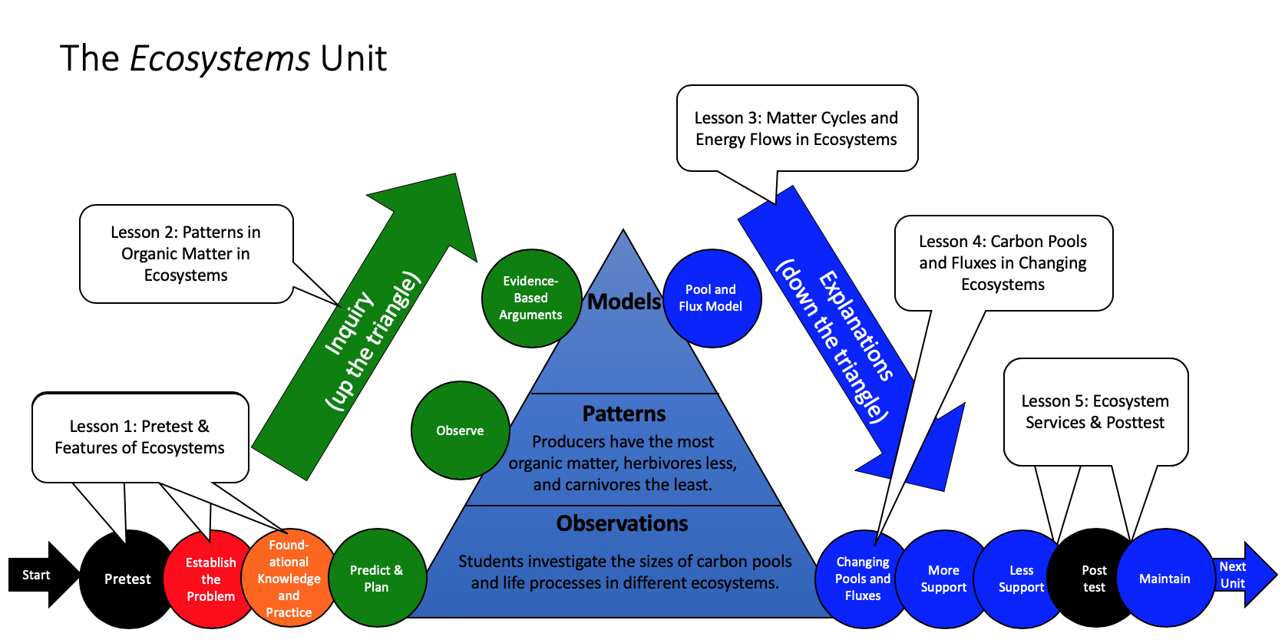
Unit map
You are here
Notes:
Use the instructional model to show students where they are in the course of the unit.
Show Slide 2 of the 2.4 Organic Carbon Pools in Other Ecosystems PPT.

Slide 3
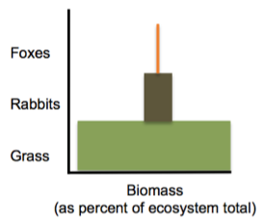
Meadow Simulation: The Organic Matter Pyramid
Are the organic matter pools in real-world ecosystems like this (Producers > Herbivores > Carnivores)?
Notes:
Discuss carbon pool sizes in different ecosystems.
Use 2.4 Organic Carbon Pools in Other Ecosystems PPT to compare the Meadow Simulation to different ecosystems.
Remind students that the Meadow Simulation was a simulation of one specific ecosystem: a meadow. Show students the organic matter pyramid on Slide 3 and discuss how it represents the patterns observed in the simulation.

Slide 4
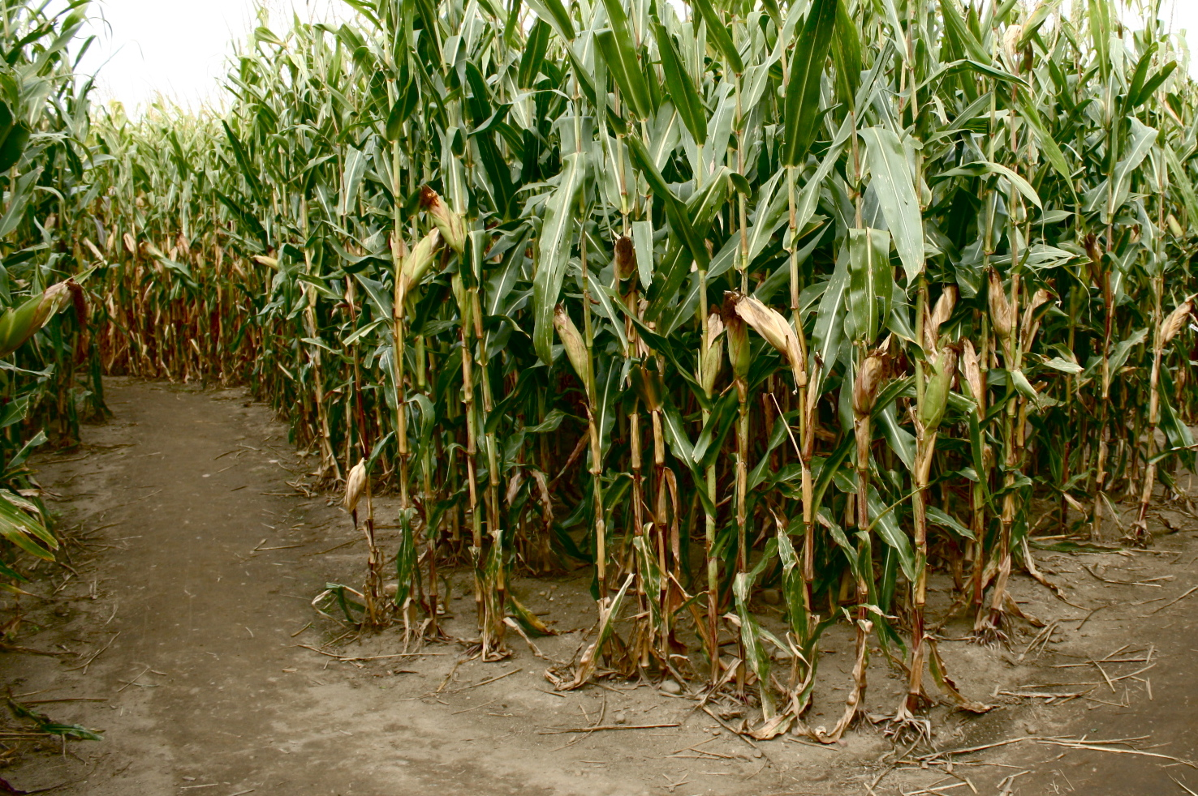
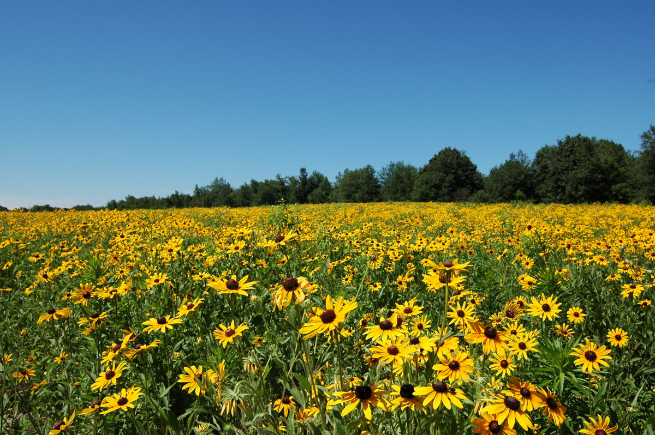
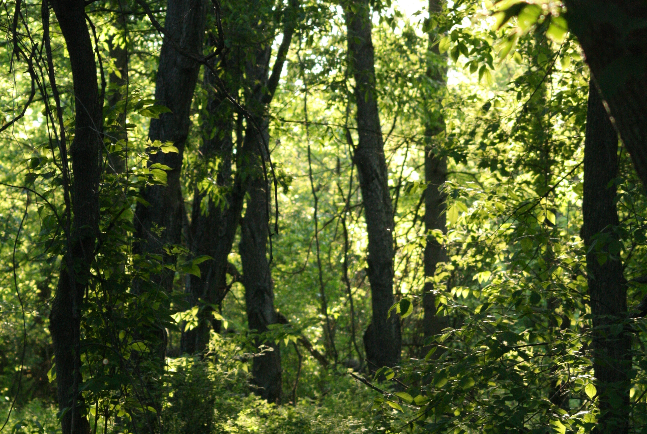
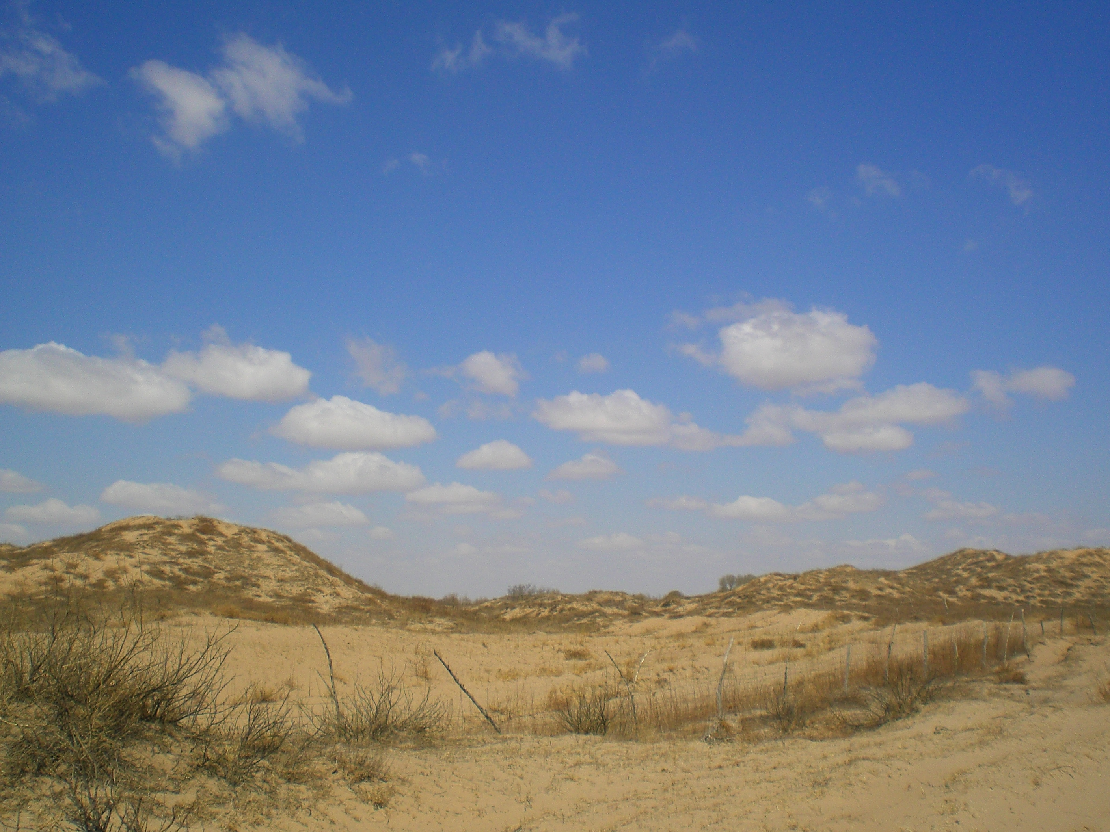
Let’s look at organic carbon pools in real ecosystems
Cornfield
Prairie
Forest
Desert
Notes:
Have students predict which ecosystems have the largest organic carbon pools.
Use Slide 4 to introduce four different types of ecosystems. Have students consider two ecosystems at a time—prairie vs. desert and cornfield vs. forest—during Slides 5-13. Students should write down a prediction on a piece of paper. Ask: Which ecosystem will have the most organic carbon? They could also predict which pool they think will be the largest.
Many students will make reasonable predictions about the amount of living organic matter, but we expect that many students will be surprised when they see that in most terrestrial ecosystems the largest organic carbon pool is soil carbon.
Accommodation: Have students share their predictions to the class for the question “Which ecosystem will have the most organic carbon?” As students share their predictions, write down these predictions on a sheet of paper or the board.

Slide 5
Which ecosystem do you think has the most organic carbon?
Prairie
Desert
Notes:
Have students predict which ecosystems have the largest organic carbon pools.
Use Slide 4 to introduce four different types of ecosystems. Have students consider two ecosystems at a time—prairie vs. desert and cornfield vs. forest—during Slides 5-13. Students should write down a prediction on a piece of paper. Ask: Which ecosystem will have the most organic carbon? They could also predict which pool they think will be the largest.
Many students will make reasonable predictions about the amount of living organic matter, but we expect that many students will be surprised when they see that in most terrestrial ecosystems the largest organic carbon pool is soil carbon.
Accommodation: Have students share their predictions to the class for the question “Which ecosystem will have the most organic carbon?” As students share their predictions, write down these predictions on a sheet of paper or the board.
Image Credit: Hannah Miller

Slide 6
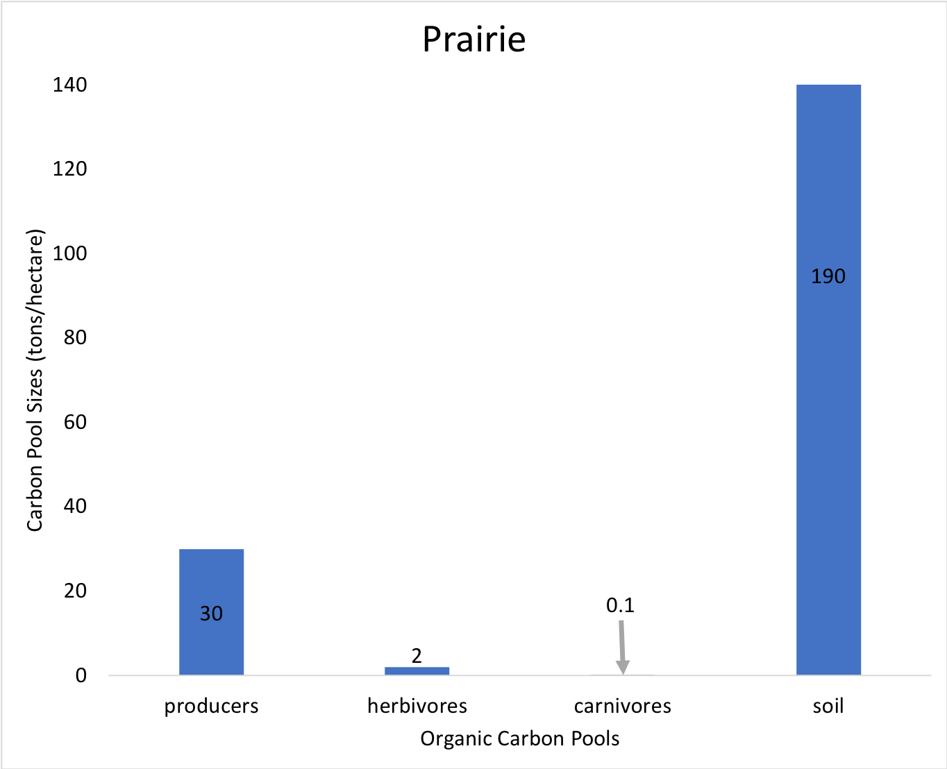
Prairie: Notice the pattern of organic carbon pool sizes (tons/hectare)
Prairie
Notes:
Have students predict which ecosystems have the largest organic carbon pools.
Use Slide 4 to introduce four different types of ecosystems. Have students consider two ecosystems at a time—prairie vs. desert and cornfield vs. forest—during Slides 5-13. Students should write down a prediction on a piece of paper. Ask: Which ecosystem will have the most organic carbon? They could also predict which pool they think will be the largest.
Many students will make reasonable predictions about the amount of living organic matter, but we expect that many students will be surprised when they see that in most terrestrial ecosystems the largest organic carbon pool is soil carbon.
Accommodation: Have students share their predictions to the class for the question “Which ecosystem will have the most organic carbon?” As students share their predictions, write down these predictions on a sheet of paper or the board.
Image Credit: Hannah Miller

Slide 7
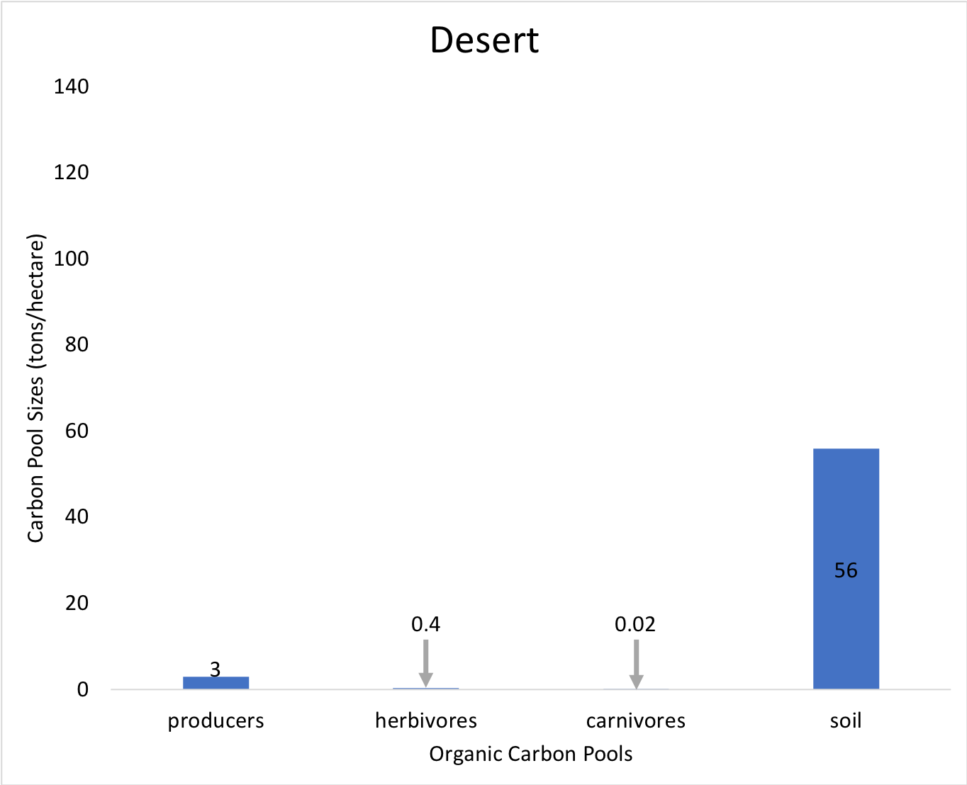
Desert: Notice the pattern of organic carbon pool sizes
Desert
Notes:
Have students predict which ecosystems have the largest organic carbon pools.
Use Slide 4 to introduce four different types of ecosystems. Have students consider two ecosystems at a time—prairie vs. desert and cornfield vs. forest—during Slides 5-13. Students should write down a prediction on a piece of paper. Ask: Which ecosystem will have the most organic carbon? They could also predict which pool they think will be the largest.
Many students will make reasonable predictions about the amount of living organic matter, but we expect that many students will be surprised when they see that in most terrestrial ecosystems the largest organic carbon pool is soil carbon.
Accommodation: Have students share their predictions to the class for the question “Which ecosystem will have the most organic carbon?” As students share their predictions, write down these predictions on a sheet of paper or the board.
Image Credit: Hannah Miller

Slide 8
Desert
Prairie
0.1
0.02
0.1
Carnivores organic carbon
Carnivores organic carbon
Atmosphere CO₂
Atmosphere CO₂
2
0.4
2
Herbivores organic carbon
Herbivores organic carbon
30
3
190
30
56
190
Soil
Organic Carbon
Producers organic carbon
Soil
Organic Carbon
Producers organic carbon
Notes:
Have students predict which ecosystems have the largest organic carbon pools.
Use Slide 4 to introduce four different types of ecosystems. Have students consider two ecosystems at a time—prairie vs. desert and cornfield vs. forest—during Slides 5-13. Students should write down a prediction on a piece of paper. Ask: Which ecosystem will have the most organic carbon? They could also predict which pool they think will be the largest.
Many students will make reasonable predictions about the amount of living organic matter, but we expect that many students will be surprised when they see that in most terrestrial ecosystems the largest organic carbon pool is soil carbon.
Accommodation: Have students share their predictions to the class for the question “Which ecosystem will have the most organic carbon?” As students share their predictions, write down these predictions on a sheet of paper or the board.

Slide 9
Which ecosystem do you think has the most organic carbon?
Cornfield
Forest
Notes:
Have students predict which ecosystems have the largest organic carbon pools.
Use Slide 4 to introduce four different types of ecosystems. Have students consider two ecosystems at a time—prairie vs. desert and cornfield vs. forest—during Slides 5-13. Students should write down a prediction on a piece of paper. Ask: Which ecosystem will have the most organic carbon? They could also predict which pool they think will be the largest.
Many students will make reasonable predictions about the amount of living organic matter, but we expect that many students will be surprised when they see that in most terrestrial ecosystems the largest organic carbon pool is soil carbon.
Accommodation: Have students share their predictions to the class for the question “Which ecosystem will have the most organic carbon?” As students share their predictions, write down these predictions on a sheet of paper or the board.
Image Credit: Hannah Miller

Slide 10
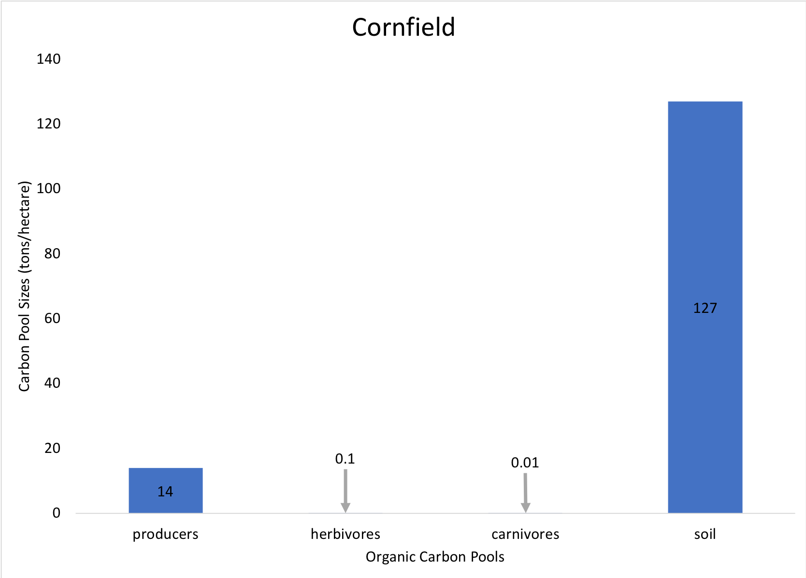
Cornfield: Notice the pattern of organic carbon pool sizes
Cornfield
Notes:
Have students predict which ecosystems have the largest organic carbon pools.
Use Slide 4 to introduce four different types of ecosystems. Have students consider two ecosystems at a time—prairie vs. desert and cornfield vs. forest—during Slides 5-13. Students should write down a prediction on a piece of paper. Ask: Which ecosystem will have the most organic carbon? They could also predict which pool they think will be the largest.
Many students will make reasonable predictions about the amount of living organic matter, but we expect that many students will be surprised when they see that in most terrestrial ecosystems the largest organic carbon pool is soil carbon.
Accommodation: Have students share their predictions to the class for the question “Which ecosystem will have the most organic carbon?” As students share their predictions, write down these predictions on a sheet of paper or the board.
Image Credit: Hannah Miller

Slide 11
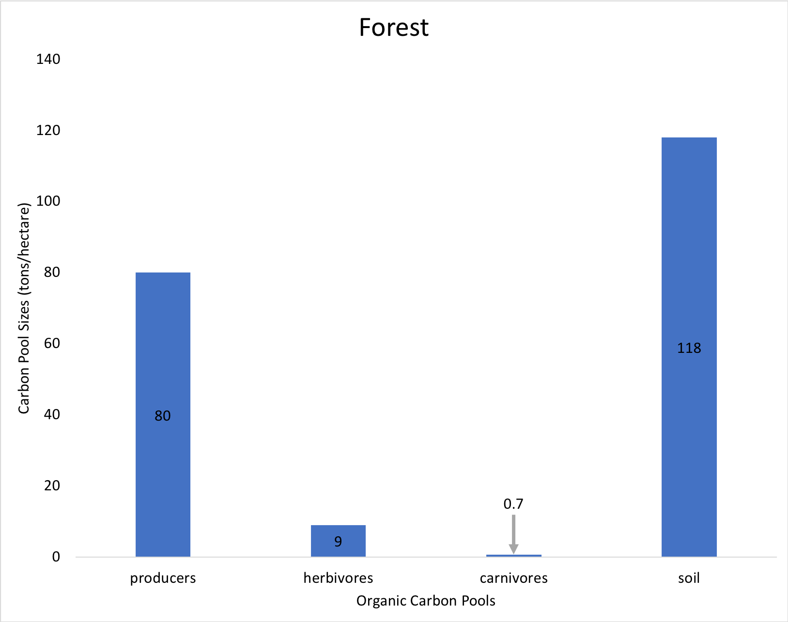
Forest: Notice the pattern of organic carbon pool sizes
Forest
Notes:
Have students predict which ecosystems have the largest organic carbon pools.
Use Slide 4 to introduce four different types of ecosystems. Have students consider two ecosystems at a time—prairie vs. desert and cornfield vs. forest—during Slides 5-13. Students should write down a prediction on a piece of paper. Ask: Which ecosystem will have the most organic carbon? They could also predict which pool they think will be the largest.
Many students will make reasonable predictions about the amount of living organic matter, but we expect that many students will be surprised when they see that in most terrestrial ecosystems the largest organic carbon pool is soil carbon.
Accommodation: Have students share their predictions to the class for the question “Which ecosystem will have the most organic carbon?” As students share their predictions, write down these predictions on a sheet of paper or the board.
Image Credit: Hannah Miller

Slide 12
Forest
Cornfield
0.7
0.01
Carnivores organic carbon
Carnivores organic carbon
Atmosphere CO₂
9
Atmosphere CO₂
0.1
Herbivores organic carbon
Herbivores organic carbon
118
80
127
14
Soil
Organic Carbon
Producers organic carbon
Soil
Organic Carbon
Producers organic carbon
Notes:
Have students predict which ecosystems have the largest organic carbon pools.
Use Slide 4 to introduce four different types of ecosystems. Have students consider two ecosystems at a time—prairie vs. desert and cornfield vs. forest—during Slides 5-13. Students should write down a prediction on a piece of paper. Ask: Which ecosystem will have the most organic carbon? They could also predict which pool they think will be the largest.
Many students will make reasonable predictions about the amount of living organic matter, but we expect that many students will be surprised when they see that in most terrestrial ecosystems the largest organic carbon pool is soil carbon.
Accommodation: Have students share their predictions to the class for the question “Which ecosystem will have the most organic carbon?” As students share their predictions, write down these predictions on a sheet of paper or the board.

Slide 13
Notes:
Have students predict which ecosystems have the largest organic carbon pools.
Use Slide 4 to introduce four different types of ecosystems. Have students consider two ecosystems at a time—prairie vs. desert and cornfield vs. forest—during Slides 5-13. Students should write down a prediction on a piece of paper. Ask: Which ecosystem will have the most organic carbon? They could also predict which pool they think will be the largest.
Many students will make reasonable predictions about the amount of living organic matter, but we expect that many students will be surprised when they see that in most terrestrial ecosystems the largest organic carbon pool is soil carbon.
Accommodation: Have students share their predictions to the class for the question “Which ecosystem will have the most organic carbon?” As students share their predictions, write down these predictions on a sheet of paper or the board.
Image Credit: Hannah Miller

Slide 14
How are all four ecosystems alike?
Soil contains the largest pool of organic carbon
The producers pools is bigger than the herbivores pool
The herbivores pool is bigger than the carnivores pool
Carnivores are the smallest pool of organic carbon
Total mass of
carnivores
Total mass of
herbivores
Total mass of
plants
Notes:
Compare four different ecosystems.
Use Slide 14 to prompt students to write down as many observations as they can about how the four ecosystems are alike and different.
The main thing they should notice is that the relative sizes of ecosystem pools is the same across ecosystems: the largest pool is the soil organic carbon, followed by producers, then herbivores, then carnivores.
They may also notice that soil organic carbon is the largest pool in the prairie, but the forest has the most organic carbon in producers. You may use this opportunity to talk about how pool sizes are different because of the history of the site (lots of grasses growing and dying increase the soil organic carbon pool) and the size of the organisms that live there (trees versus corn).
They should also notice that the total organic carbon differs across ecosystems.
They may also notice that human management produces a somewhat different pattern for the corn field. Humans use fences, hunting, and pesticides to kill or keep out most herbivores (since we want to use the corn for ourselves), so the herbivore and carnivore populations are much smaller than for natural ecosystems.

Slide 15
How are the ecosystems different?
Different ecosystems have different total amounts of organic carbon (soil + producers + herbivores + carnivores).
Why do you think different ecosystems have different total amounts of organic carbon?
Notes:
Compare four different ecosystems.
Use Slide 15 to introduce the ideas differ in the total organic carbon that they can support Students will be explore this idea more deeply more in Lesson 4. Ecologists answer the last question (about why different ecosystems have different amounts of total organic carbon) by identifying limiting factors, including:
Water (the primary limiting factor for deserts)
Temperature (the primary limiting factor in Arctic and alpine ecosystems)
Nutrient availability (the primary limiting factor in rain forests)
This is a good time elicit students’ ideas and questions about what limits organic carbon in different ecosystems. You do not need to teach about limiting factors at this point.
Accommodation: For the information on the final slide, as a class create organic matter pyramids or other bar graphs to show the size of the pools as visuals. Have students describe the organic matter pools in the four ecosystems (desert, forest, corn field, and prairie) including the herbivores, producers, and carnivores that live in each ecosystem.

Slide 16
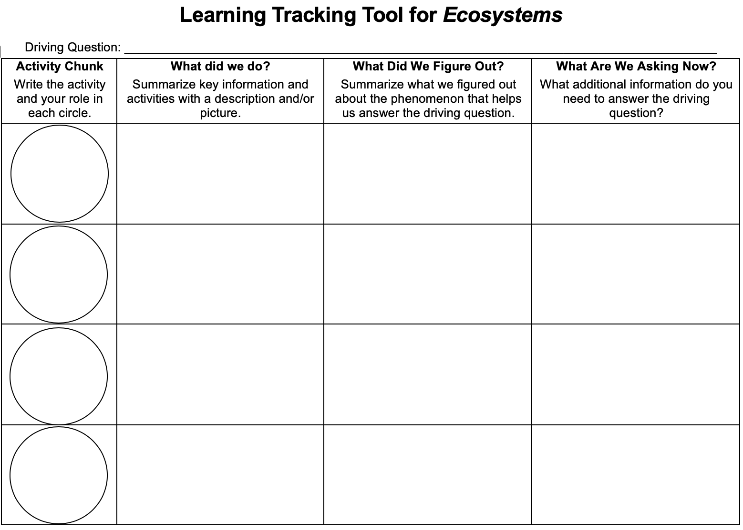
Learning Tracking Tool
Record the activity chunk name “Patterns in Organic Matter Pools, Investigator.”
Discuss what you did during the activity chunk and record your ideas in the column, “What Did We Do?”
Discuss with your classmates what you figured out will help you to answer the unit driving question. Record your ideas in the column “What Did We Figure Out?”
Discuss questions you now have related to the unit driving question and record them in the column “What Are We Asking Now?”
Notes:
Have a discussion to complete the Learning Tracking Tool for this activity.
Show Slide 16 of the 2.4 Questions about Ecosystems PPT.
Pass out a Learning Tracking Tool for Ecosystems to each student.
Have students write the activity chunk name in the first column, "The Meadow Simulation."
Have a class discussion about what students did during the activity chunk. When you come to consensus as a class, have students record the answer in the second column of the tool.
Have a class discussion about what students figured out during the activity chunk that will help them in answering the unit driving question. When you come to consensus as a class, have students record the answer in the third column of the tool.
Have a class discussion about what students are wondering now that will help them move towards answering the unit driving question. Have students record the questions in the fourth column of the tool.
Have students keep their Learning Tracking Tool for Ecosystems for future activities.
Example Learning Tracking Tool
Activity Chunk: Patterns in Organic Matter Ecosystems, Investigator
What Did We Do? Use the Meadow Simulation to investigate an ecosystem. Use the Predictions and Planning Tool and the Evidence-Based Arguments Tool to describe patterns.
What Did We Figure Out? Most terrestrial ecosystems have an organic matter pyramid: Producers organic matter > herbivore organic matter > carnivore organic matter.
What Are We Asking Now? What causes the organic matter pyramid?

