Slide 1
Ecosystems Unit Activity 1.2 Expressing Ideas and Questions for Patterns in Ecosystems
Carbon: Transformations in Matter and Energy
Environmental Literacy Project Michigan State University
Notes:
Image Credit: Craig Douglas, Michigan State University
Have students discuss the pretest.
Ask students to write down questions they have after taking the pretest (for instance, on their 1.2 Expressing Ideas and Questions Tool for Ecosystems). Explain that we will try to answer most of those during the Ecosystems Unit.
(Optional) Have students complete the Big Idea Probe: Wolves and Deer.
If you decide to use the Big Idea Probe: Wolves and Deer, have students complete it and share their ideas. See Assessing the Big Idea Probe: Wolves and Deer and the educator resource Using Big Idea Probes in Carbon TIME for suggestions about how to use the Big Idea Probe.

Slide 2
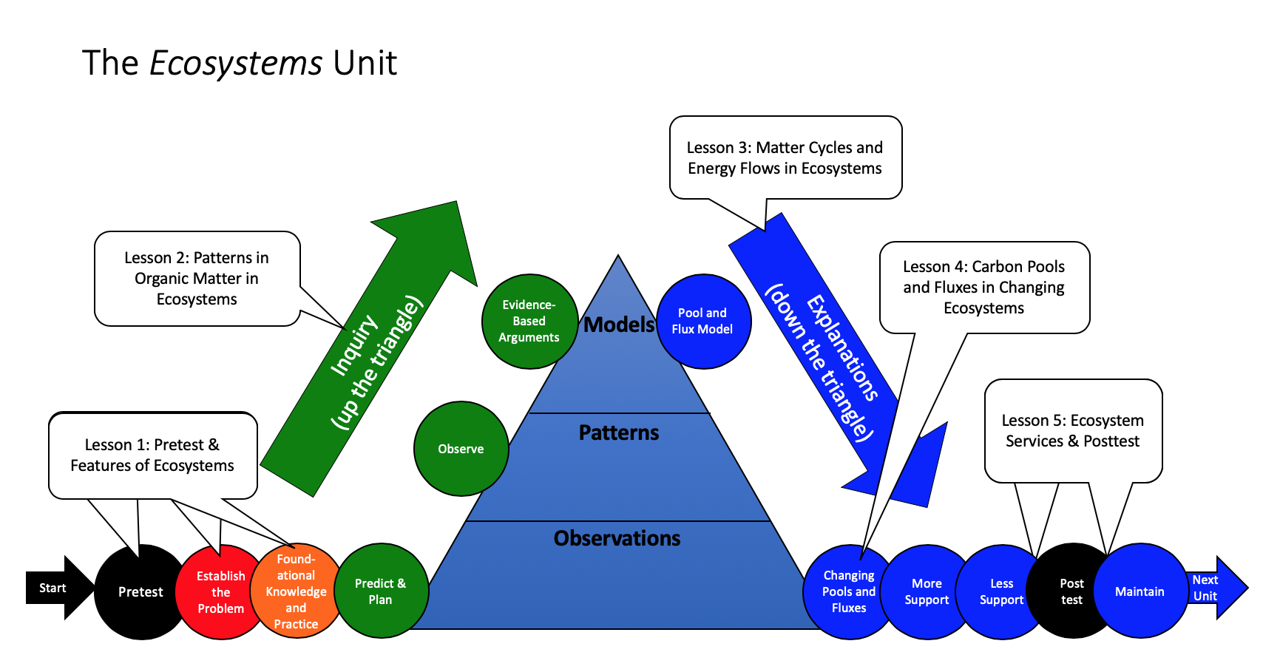
Unit Map
You are here
Notes:
Use the instructional model to show students where they are in the course of the unit.
Show Slide 2 of the 1.2 Expressing Ideas and Questions for Patterns in Ecosystems PPT.

Slide 3
Expressing Your Ideas and Questions
Use this tool to record your ideas and questions about ecosystems.
It’s okay if you don’t know the “right answer” at this point!
At the end, you will have a chance to share your ideas and hear the ideas of your classmates.
Notes:
Students complete the Expressing Ideas and Questions Tool on their own.
Show Slide 3 of the 1.2 Expressing Ideas and Questions for Patterns in Ecosystems PPT.
Tell students that now they will take a few minutes to think and record their ideas and questions about ecosystems on their own.
Give each student one copy of 1.2 Expressing Ideas and Questions Tool for Ecosystems.
Give students about 10 minutes to complete the tool as individuals.
Encourage students to think about things they have seen in the world to help inform their ideas.

Slide 4
Comparing Ideas and Questions with a Partner
While you’re working, I’ll come around to check in:
Do you agree with each other’s ideas? Why or why not?
Where did you learn about your ideas?
What experiences have you had to help you with your explanation?
Notes:
Students compare their own ideas with the ideas of a partner.
Show Slide 4 of the 1.2 Expressing Ideas and Questions for Patterns in Ecosystems PPT.
Tell students that now that they have had a chance to record their ideas and questions on their own, it is important to compare their ideas to their classmates' ideas to see how they are similar and different, and also so we know how many different ideas there are in the class.
Divide students into pairs and have students compare their ideas on the 1.2 Expressing Ideas and Questions Tool for Ecosystems with each other. As students are sharing, circulate through the groups. Consider asking questions such as Do you agree with each other about XX? Where did you learn about that? What experiences have you had to help you with your explanation?
At this point, do not correct any wrong ideas; treat this as brainstorming.
Pay attention to patterns in students’ ideas, or specific individual ideas that diverge from the patterns as both may be valuable to discuss as a whole class later.

Slide 5
Posting Ideas for Class Discussion
Your ideas:
Your questions:
Notes:
Post ideas for class discussion.
Tell students that now that they have had a chance to write their ideas as individuals and as pairs, it is important to look at the range of ideas in the class. Again, at this point, do not correct any wrong ideas. Treat this as brainstorming: all ideas are on the table.
Show Slide 5 of the 1.2 Expressing Ideas and Questions about Ecosystems PPT.
Give each pair 2 sticky notes.
Tell students to write their most important idea from their Expressing Ideas and Question Tools on a sticky note and put it on the board under the “Your Ideas” column.
Tell students to write their most important question from their Expressing Ideas and Questions Tools on a sticky note and put it on the board under the “Your Questions” column.

Slide 6
Discussing Our Ideas
Your ideas:
Your questions:
Notes:
Have a whole class discussion.
Lead a whole class discussion to examine the variety of student ideas and questions on the board. Draw out and press students to build on their ideas about how a fox in a meadow ecosystem gets the matter and energy it needs to live and grow.
This is the consensus-seeking stage of the Carbon TIME Discourse Routine . It is especially important for students to agree on some shared questions.
Show Slide 6 of the 1.2 Expressing Ideas and Questions for Patterns in Ecosystems PPT. Note that this slide is a duplicate of the previous one but with a new heading. Take this time to discuss students’ ideas, organize them according to patterns, etc.
Later, you can use this duplicate slide as a record of class ideas for the future, either by saving the post-it notes or by taking a picture of them. You may want to record the students’ ideas and questions on a class Driving Question Board . Link to Carbon_TIME_Discourse_Routine.docx in Library. I have added this file to 2.12.6.3 Recurring Features and Strategies.
Link to Driving_Question_Board_Educator_Resource.docx in Library. I have added this file to 2.12.6.3 Recurring Features and Strategies.

Slide 7
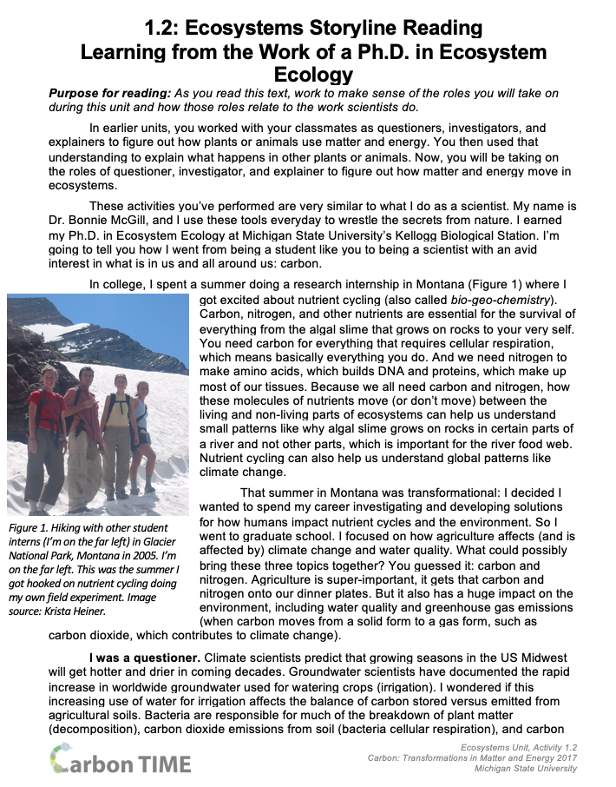
Reading
Read the “Ecosystems Storyline Reading” using the Questions, Connections, Questions Reading Strategy.
Notes:
8. Students read the Ecosystems Storyline Reading
Show Slide 7 of the 1.2 Expressing Ideas and Questions for Patterns in Ecosystems PPT. Have students partner-read the 1.2 Ecosystems Storyline Reading which explains the storyline of the unit and connects it to the work of scientist Dr. Bonnie McGill. Read using the Questions, Connections, Questions Student Reading Strategy. See the Engaging Students with Readings and the Questions, Connections, Questions Reading Strategy Educator Resource document for information about how to engage students with this strategy.
After pairs are finished reading, have students share with the class what they found interesting and any questions they have.

Slide 8
Save for later
Later, you will compare your ideas from today to your predictions and explanations.
Notes:
Save the Expressing Ideas and Questions Tools for later.
Show Slide 8 of the 1.2 Expressing Ideas and Questions for Patterns in Ecosystems PPT.
Tell students that they will revisit these ideas and question later in the unit to see how their thinking changes and what they have learned.
The class can also return to shared ideas on Slide 6.

