Slide 1
Ecosystems Unit Activity 2.3 Evidence-Based Arguments for the Meadow Simulation
Carbon: Transformations in Matter and Energy
Environmental Literacy Project Michigan State University

Slide 2
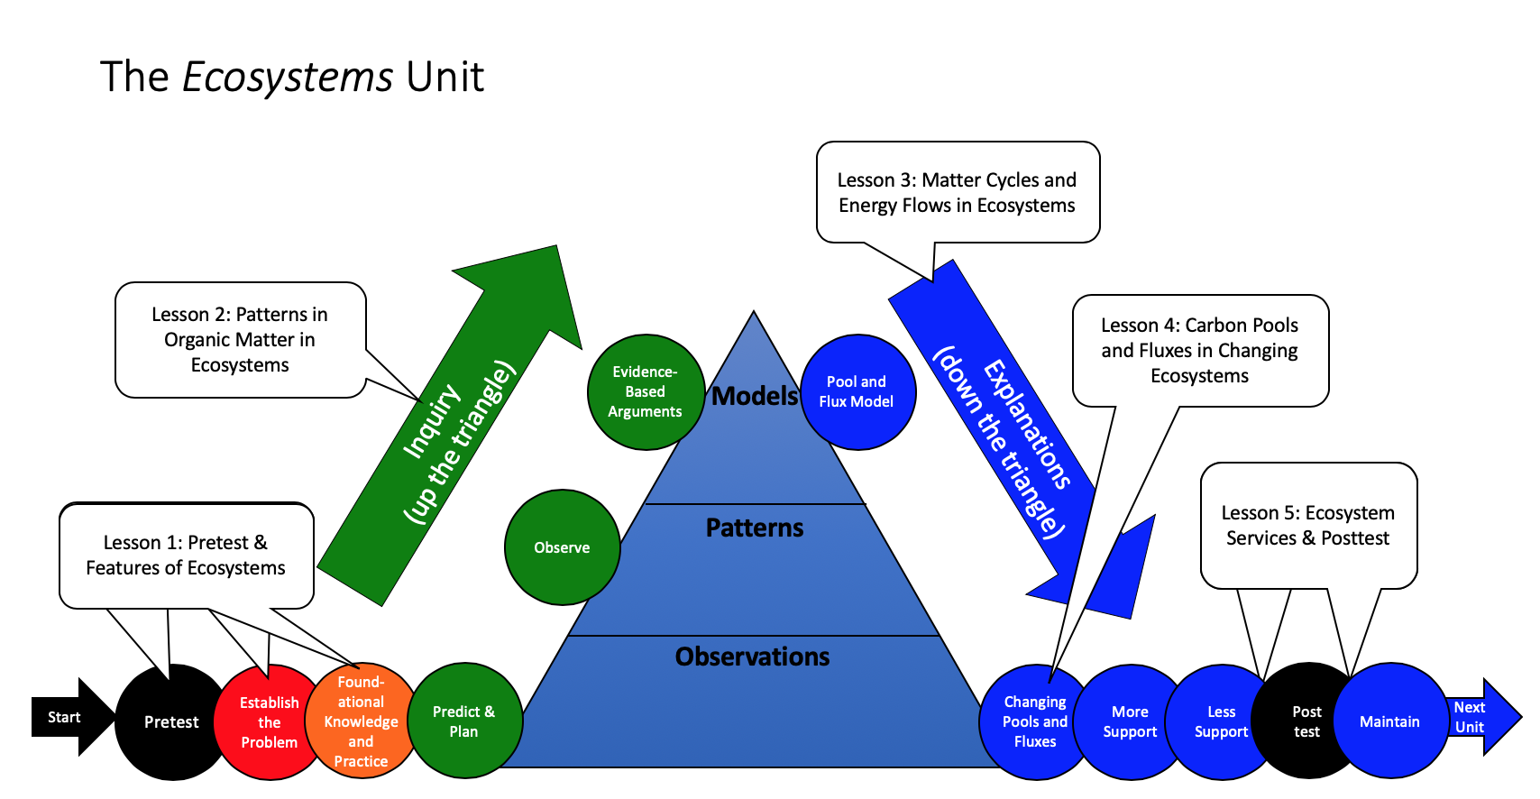
Unit map
You are here
Notes:
Use the instructional model to show students where they are in the course of the unit.
Show Slide 2 of the 2.3 Evidence-Based Arguments for the Meadow Simulation PPT.

Slide 3
Complete the Evidence-Based Arguments Tool
Notes:
Students complete the Evidence-Based Arguments Tool.
Ask students to take out their completed 2.2 Meadow Simulation Worksheet.
Display Slide 3. Pass out one copy of 2.3 Evidence-Based Arguments Tool for the Meadow Simulation to each student. Review the Tool directions. Instruct students to use their data from the 2.2 Meadow Simulation Worksheet as well as what they learned from class discussion to complete the tool.
Give students about 5-10 minutes to complete the process tool.

Slide 4
Comparing ideas with a partner
Compare your evidence, conclusions, and unanswered questions for each of the Three Questions.
How are they alike?
How are they different?
Consider making revisions to your argument based on your conversation with your partner.
Notes:
Have students compare and revise arguments in pairs.
Display Slide 4 of the 2.3 Evidence-Based Arguments for the Meadow Simulation PPT. Divide students into pairs.
Have each pair compare their evidence, conclusions, and unanswered questions for the questions on the Evidence-based Arguments Tool.
Have partners discuss how their ideas are alike and different. Have students change or add to their responses, based on partner input.
As students are sharing, circulate through the groups. Ask students about the patterns they observed.
Pay attention to patterns in students’ ideas. You will want to begin moving towards class consensus in this activity.
Partner work should take about 10 minutes.

Slide 5
Question 1: What happens over 100 years when each population starts with an organic matter mass of 500?
Evidence | Conclusions | Unanswered Questions
Notes:
Have a class discussion of the Question 1 on the Evidence-Based Arguments Tool; move toward class consensus.
This is the consensus-seeking discussion part of the Discourse Routine for the Evidence-Based Arguments Tool.
Display Slide 5 of the 2.3 Evidence-Based Arguments for the Meadow Simulation PPT.
Have students/pairs share their evidence and conclusions for the first row. Keep a class record, using the PPT slides or board. Ask students to update their answers using a different colored writing utensil. Discussions should move toward class consensus.
Have students share unanswered questions. Discussions should move toward class consensus. Use the 2.3 Assessing the Evidence-Based Arguments Tool for Meadow Simulation to guide your goals for consensus. At this point in this unit you will begin to guide the path of inquiry toward tracing matter and energy in ecosystems.
Class discussion should take about 10 minutes.

Slide 6
Question 2: What settings lead to the highest fox organic matter after 100 years?
Evidence | Conclusions | Unanswered Questions
Notes:
Have a class discussion of the Questions 2 and 3 on the Evidence-based Arguments Tool; move toward class consensus.
Display Slides 6 and 7 of the 2.3 Evidence-Based Arguments about the Meadow Simulation PPT.
Class discussion may take another 10 minutes.

Slide 7
Question 3: What settings lead to all the foxes dying?
Evidence | Conclusions | Unanswered Questions
Notes:
Have a class discussion of the Questions 2 and 3 on the Evidence-based Arguments Tool; move toward class consensus.
Display Slides 6 and 7 of the 2.3 Evidence-Based Arguments about the Meadow Simulation PPT.
Class discussion may take another 10 minutes.

Slide 8
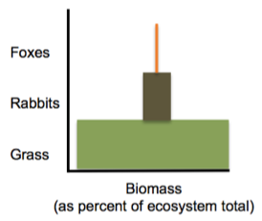
Conclusion #1: The Organic Matter Pyramid
The organic matter diagram that shows the maximum fox and rabbit mass in the Meadow Simulation resembles a pyramid.
Notes:
Review the conclusions from the investigation.
Use Slides 8 and 9 to review the two main conclusions that students should have on their Evidence-Based Arguments Tool:
The organic matter diagram that represents the maximum mass of all three populations after 100 years resembles a pyramid (this diagram is also called the organic matter pyramid). Ask students to share their ideas about why so much grass is necessary to support so few foxes. They will learn more about this in Lesson 3.
There are three possible final mass diagrams that could occur in the meadow ecosystem (the organic matter pyramid with all three populations, rabbits and grasses only, and grasses only). Students can share ideas about how the foxes and rabbits could all die (if the rabbit population dipped so low that the foxes died out, but there were still a few rabbits left to reproduce and repopulate the meadow).

Slide 9
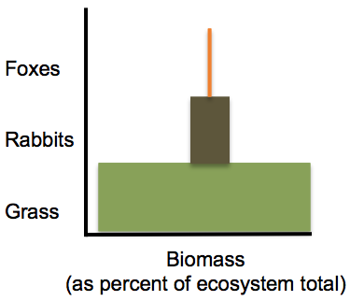
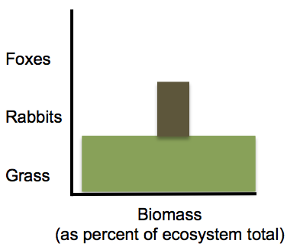
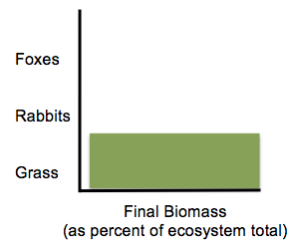
Conclusion #2: When Foxes All Die
Only three final organic matter diagrams are possible in the meadow ecosystem. Foxes are more likely to die out than rabbits or grass.
Notes:
Review the conclusions from the investigation.
Use Slides 8 and 9 to review the two main conclusions that students should have on their Evidence-Based Arguments Tool:
The organic matter diagram that represents the maximum mass of all three populations after 100 years resembles a pyramid (this diagram is also called the organic matter pyramid). Ask students to share their ideas about why so much grass is necessary to support so few foxes. They will learn more about this in Lesson 3.
There are three possible final mass diagrams that could occur in the meadow ecosystem (the organic matter pyramid with all three populations, rabbits and grasses only, and grasses only). Students can share ideas about how the foxes and rabbits could all die (if the rabbit population dipped so low that the foxes died out, but there were still a few rabbits left to reproduce and repopulate the meadow).

Slide 10
Discussion Questions
What are the processes that lead to the organic matter pyramid?
Why are foxes more likely to die out than rabbits or grass?
Notes:
Conclude the discussion of the meadow ecosystem and identify unanswered questions for future lessons.
Use Slide 10 to emphasize that the organic matter pyramid is an important pattern in ecosystems, but that we have not yet explained what causes this pattern. That will be the focus of Lesson 3.

Slide 11
Results of the Meadow Simulation
Take out your completed 2.2 Meadow Simulation Worksheet
What was the maximum organic mass of foxes that you observed at the end of the 100-year simulation (any trial)?
What was the maximum organic mass of rabbits that you observed at the end of the 100-year simulation (any trial)?
What was the maximum organic mass of grasses that you observed at the end of the 100-year simulation (any trial)?
Notes:
Discuss results of the Meadow Ecosystem investigation.
Ask students to take out their completed 2.2 Meadow Simulation worksheet. Use slide 3 to discuss the maximum biomass of foxes and rabbits that students observed in any trial of the investigation. Make sure that they recognize that many different initial settings lead to the same final outcomes (maximum biomass of foxes = 9 and maximum biomass of rabbits = 90).

Slide 12
Discussion Questions
In any trials did foxes completely die out? How do we explain this?
If grasses, rabbits, and foxes all survived for 100 years, the final mass of each population at the end of the simulation was always about the same. How do we explain this?
Notes:
Use slide 6 to ask In any trials did you get foxes completely die out? How do we explain this?
Make sure that students recognize that if the rabbits do not have enough food (grasses) that they die off, which in turn removes the food source for the foxes, which causes them to die off.
Ask If grasses, rabbits, and foxes all survived for 100 years, the final biomass of each population at the end of the simulation was always the same. How do we explain this? Help students to recognize that foxes eat rabbits and rabbits eat grasses. If all three populations are going to survive then the biomass of grasses must be greater than the rabbits, and the biomass of the rabbits must be greater than the foxes.

Slide 13
Meadow Simulation Class Results: What initial biomass settings lead to the highest fox biomass?
 | Initial settings | 100 years later
Foxes biomass
Rabbits biomass
Grass biomass
 | Initial settings | 100 years later
Foxes biomass
Rabbits biomass
Grass biomass
 | Initial settings | 100 years later
Foxes biomass
Rabbits biomass
Grass biomass
Notes:
Discuss the initial settings that resulted in the highest fox biomass at the end of the simulation.
Use slide 5 to record the data (initial and final biomass of grasses, rabbits, and foxes) from at least 3 groups. Students should recognize that many different initial settings lead to the same outcome. Ask students to share their ideas about how different initial settings could lead to the same outcome.

Slide 14
How are pools and the biomass pyramid related?
Carnivores organic carbon
Atmosphere CO₂
Herbivores organic carbon
Soil
Organic Carbon
Producers organic carbon
Notes:
Make connections between the Carbon Pools and the Biomass Pyramid.
Tell students that in previous activities they discussed the biomass pyramid. This divides the meadow ecosystem into three simple pools: Producers, Herbivores, and Carnivores.
Use Slide 15 to show how the pools and the biomass pyramid relate to each other. Ask students to identify differences between the two.
See if they notice that in the biomass pyramid the atmosphere is not represented, yet this is a key pool in our new ecosystem model!

